Slide 1

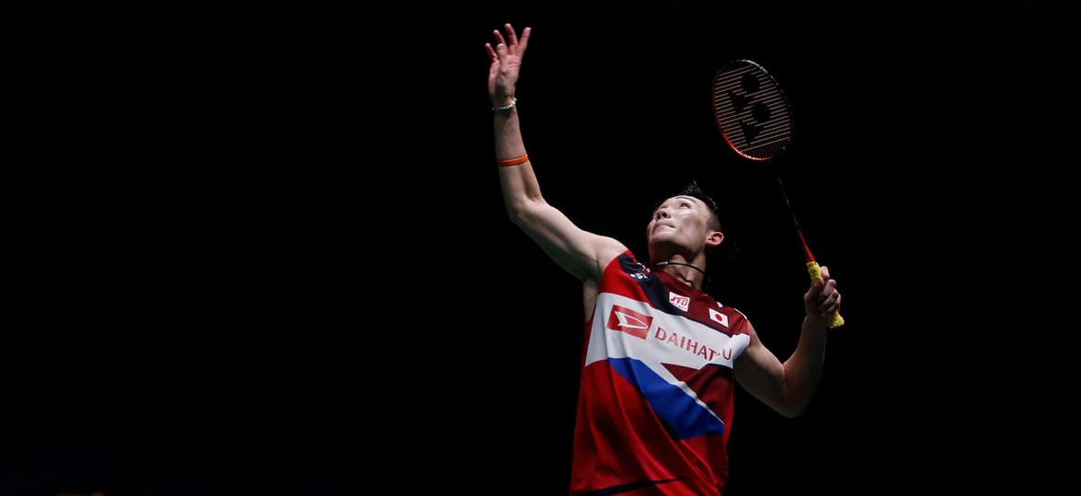





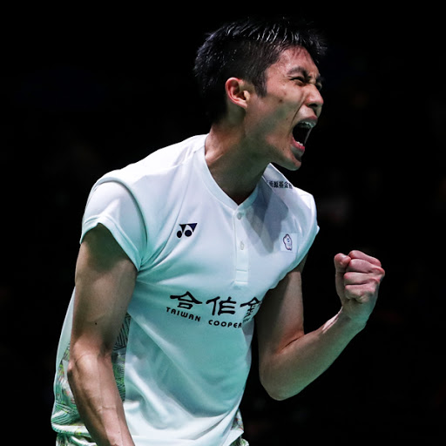



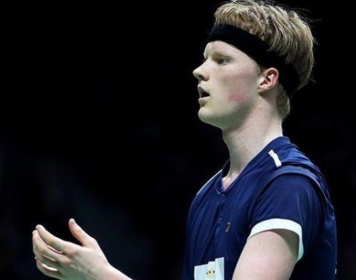
Top 3 World Ranking
As of 17 March 2020
Men’s Singles
#1 Kento MOMOTA
52
Winning Rate per Round (%)
minutes/match
102/117
Wins of total matches
Number of Titles per Final Rounds:
Shutterstock
Winning Rate per Round (%)
#2 CHOU Tien Chen
54
minutes/match
89/121
Wins of total matches
Number of Titles per Final Rounds:
Yonex
#3 Anders ANTONSEN
Winning Rate per Round (%)
54
minutes/match
46/76
Wins of total matches
Number of Titles
per Final Rounds:
Anders Antonsen’s IG
R1: Round 1/ Round 32 R2: Round 2/Round 16 QF: Quarterfinal
SF: Semifinal F: Final
Calculations only based on matches from BWF World Tour ≥ S300 Level, starting from 2018 to All England 2020
Match Sources: bwfbadminton.com

Slide 2
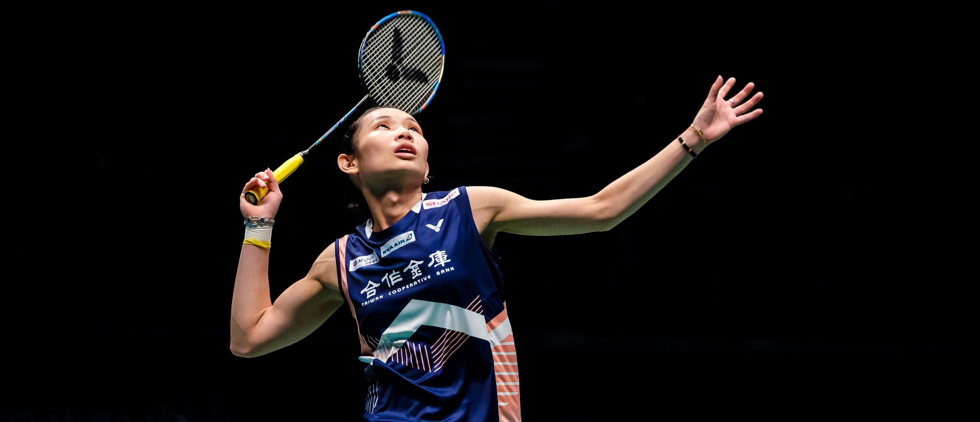





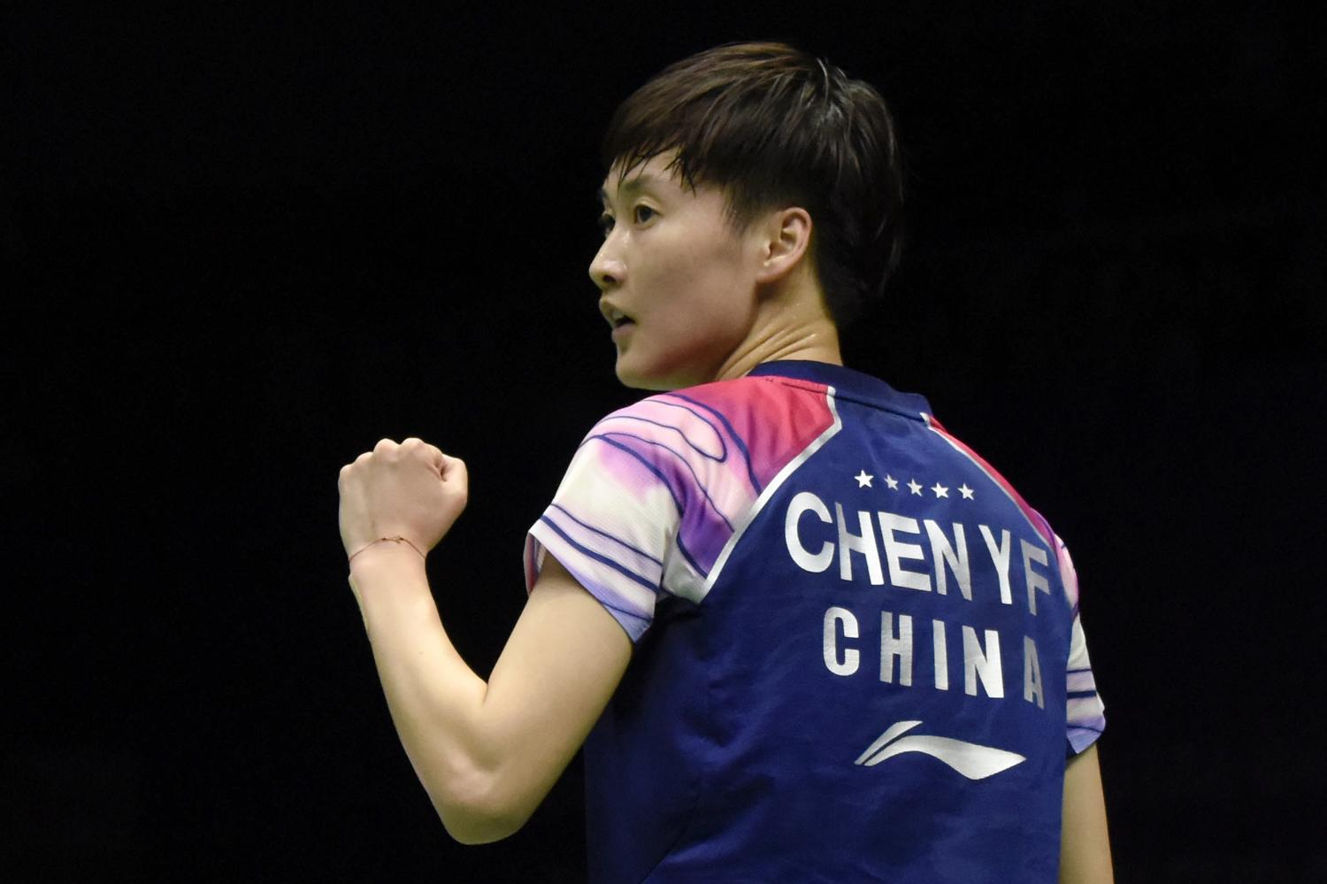

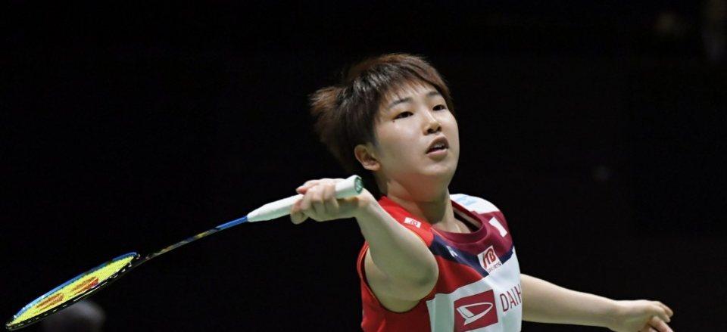
Top 3 World Ranking
As of 17 March 2020
Women’s Singles
Winning Rate per Round (%)
#1 TAI Tzu Ying
41
minutes/match
94/112
Wins of total matches
Number of Titles per Final Rounds:
Bonma Suriya - Shutterstock
#2 CHEN Yu Fei
Winning Rate per Round (%)
46
minutes/match
93/117
Wins of total matches
Number of Titles per Final Rounds:
Bangkok Post
Winning Rate per Round (%)
#3 Akane YAMAGUCHI
44
minutes/match
85/116
Wins of total matches
Number of Titles per Final Rounds:
Kyodo News
R1: Round 1/ Round 32 R2: Round 2/Round 16 QF: Quarterfinal
SF: Semifinal F: Final
Calculations only based on matches from BWF World Tour ≥ S300 Level, starting from 2018 to All England 2020
Match Sources: bwfbadminton.com

Slide 3


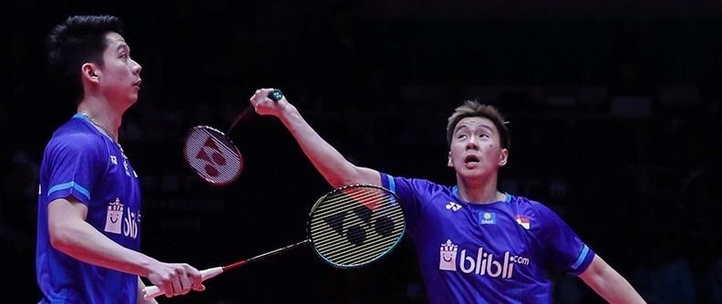


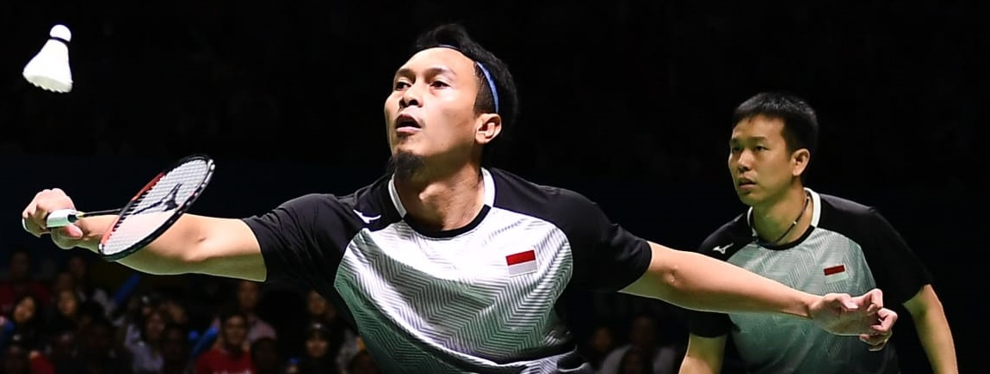
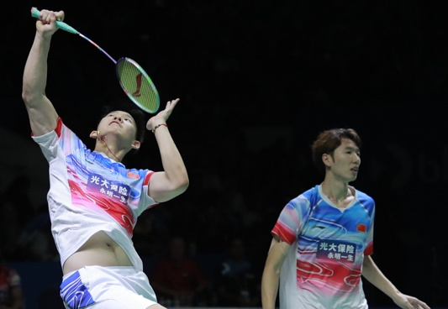
Top 3 World Ranking
As of 17 March 2020
Men’s Doubles
#1 Marcus Fernaldi GIDEON/Kevin Sanjaya SUKAMULJO
Winning Rate per Round (%)
38
Number of Titles
per Final Rounds:
minutes/match
114/129
Wins of total
matches
Badminton Indonesia
37
#2 Mohammad AHSAN/Hendra SETIAWAN
minutes/match
Winning Rate per Round (%)
86/118
Wins of total matches
Number of Titles per Final Rounds:
Olympic Channel
#3 LI Jun Hui/LIU Yu Chen
Winning Rate per Round (%)
44
minutes/match
76/105
Wins of total matches
Number of Titles per Final Rounds:
Djarum Badminton
R1: Round 1/ Round 32 R2: Round 2/Round 16 QF: Quarterfinal
SF: Semifinal F: Final
Calculations only based on matches from BWF World Tour ≥ S300 Level, starting from 2018 to All England 2020
Match Sources: bwfbadminton.com

Slide 4

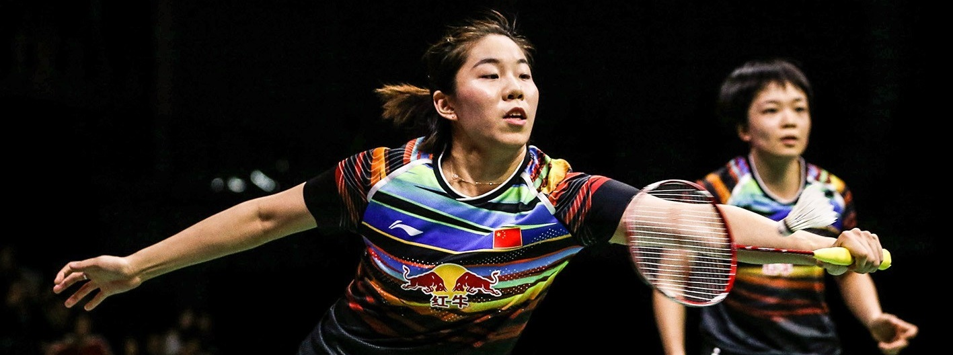


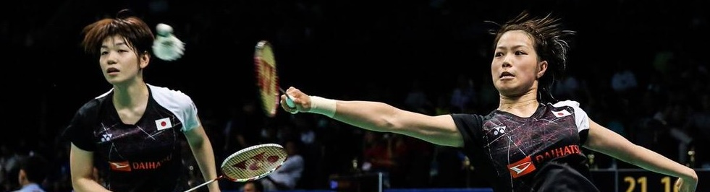
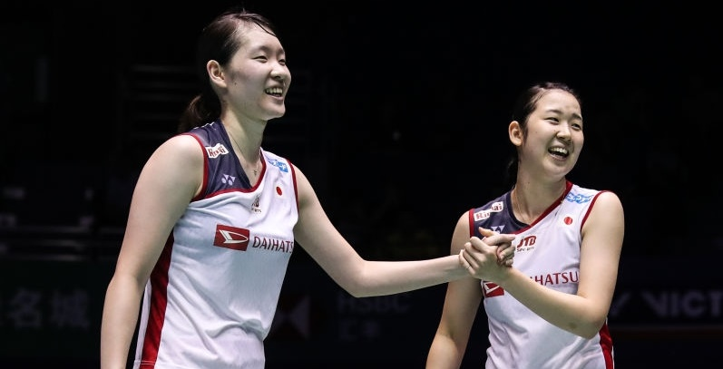
Top 3 World Ranking
As of 17 March 2020
Women’s Doubles
Winning Rate per Round (%)
#1 CHEN Qing Chen/JIA Yi Fan
50
minutes/match
42/54
Wins of total matches
Number of Titles
per Final Rounds:
Badminton Famly
#2 Yuki FUKUSHIMA/Sayaka HIROTA
Winning Rate per Round (%)
52
minutes/match
98/122
Wins of total matches
Number of Titles per Final Rounds:
Shi Tang – Badminton Now
#3 Mayu MATSUMOTO/Wakana NAGAHARA
Winning Rate per Round (%)
46
minutes/match
87/119
Wins of total matches
Number of Titles per Final Rounds:
Getty Images
R1: Round 1/ Round 32 R2: Round 2/Round 16 QF: Quarterfinal
SF: Semifinal F: Final
Calculations only based on matches from BWF World Tour ≥ S300 Level, starting from 2018 to All England 2020
Match Sources: bwfbadminton.com

Slide 5
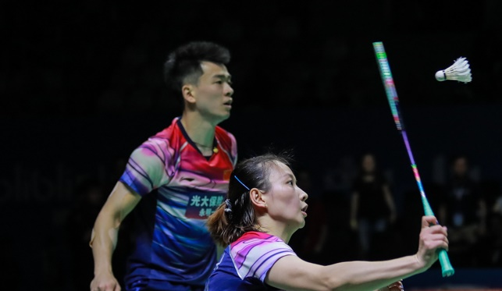




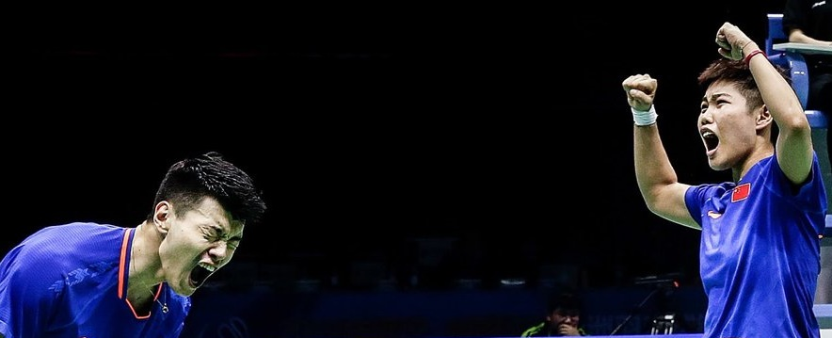

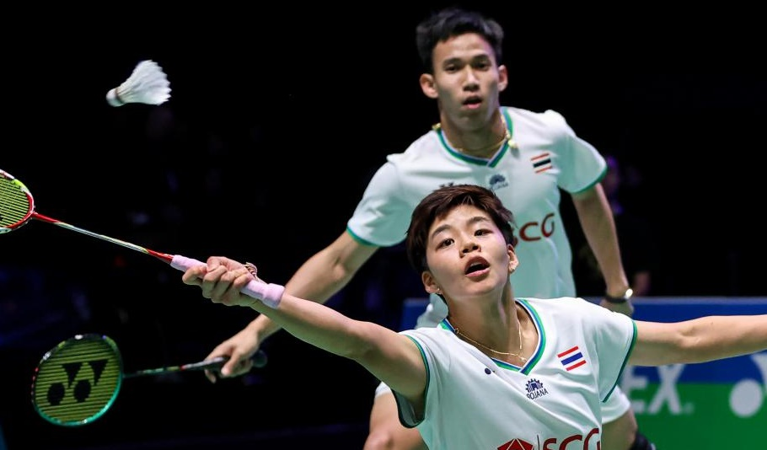
Top 3 World Ranking
As of 17 March 2020
Mixed Doubles
Shutterstick
#1 ZHENG Si Wei/HUANG Ya Qiong
36
Winning Rate per Round (%)
minutes/match
109/122
Wins of total matches
Number of Titles per Final Rounds:
Djarum Badminton
#2 WANG Yi Lyu/HUANG Dong Ping
Winning Rate per Round (%)
Number of Titles
per Final Rounds:
40
minutes/match
91/113
Wins of total matches
Getty Images
#3 Dechapol PUAVARANUKROH/
Sapsiree TAERATTANACHAI
Winning Rate per Round (%)
44
minutes/match
86/120
Wins of total matches
Number of Titles per Final Rounds:
Bangkok Post
R1: Round 1/ Round 32 R2: Round 2/Round 16 QF: Quarterfinal
SF: Semifinal F: Final
Calculations only based on matches from BWF World Tour ≥ S300 Level, starting from 2018 to All England 2020
Match Sources: bwfbadminton.com

